Slide 1









My Number Interactive Notebook
$$×$$
$$\frac{1}{2}$$
$$÷$$
$$+$$
$$−$$
$$\frac{3}{5}$$
$$7$$
Name
Class
Teacher
Term 1 Semester 1
$$5^{2}$$
$$\sqrt{9}$$
1

Slide 2
Contents
Glossary or Formula Page
Page
Date
Description
2
3

Slide 3
Tasks
24
7
30
Essential Question
Questions
Notes
Summary
6
7

Slide 4
24
7
30
Date
Index Laws
EQ – Describe how the index laws can be used to simplify expressions with indices.
5

Slide 5

Task –Expand the following
$3^{4}×3^{2}$
$\frac{3^{7}}{3^{4}}$

Slide 6

Task –Expand the following
$3^{4}×3^{2}=3×3×3×3×3×3$
$\frac{3^{7}}{3^{4}}$
Now simplify your answers

Slide 7

Task –Expand the following
$3^{4}×3^{2}=3×3×3×3×3×3=3^{6}$
$\frac{3^{7}}{3^{4}}=\frac{3×3×3×3×3×3×3}{3×3×3×3}$
Now simplify your answers

Slide 8

Task –Expand the following
$3^{4}×3^{2}=3×3×3×3×3×3=3^{6}$
$\frac{3^{7}}{3^{4}}=\frac{3×3×3×3×3×3×3}{3×3×3×3}$
Now simplify your answers

Slide 9

Task –Expand the following
$3^{4}×3^{2}=3×3×3×3×3×3=3^{6}$
$\frac{3^{7}}{3^{4}}=\frac{3×3×3×3×3×3×3}{3×3×3×3}=3×3×3=3^{3}$
Now simplify your answers

Slide 10
Task –Expand the following
$3^{4}×3^{2}=3×3×3×3×3×3=3^{6}$
$\frac{3^{7}}{3^{4}}=\frac{3×3×3×3×3×3×3}{3×3×3×3}=3×3×3=3^{3}$
Now simplify your answers

Slide 11
Task –Expand the following
$3^{4}×3^{2}=3×3×3×3×3×3=3^{6}$
$\frac{3^{7}}{3^{4}}=\frac{3×3×3×3×3×3×3}{3×3×3×3}=3×3×3=3^{3}$

Slide 12
Task –Expand the following
$3^{4}×3^{2}=3×3×3×3×3×3=3^{6}$
$\frac{3^{7}}{3^{4}}=\frac{3×3×3×3×3×3×3}{3×3×3×3}=3×3×3=3^{3}$

Slide 13
Task –Expand the following
$3^{4}×3^{2}=3×3×3×3×3×3=3^{6}$
$\frac{3^{7}}{3^{4}}=\frac{3×3×3×3×3×3×3}{3×3×3×3}=3×3×3=3^{3}$

Slide 14

24
7
30
Date
Index Laws
EQ – Describe how the index laws can be used to simplify expressions with indices.
What are the index laws?
Index Law
Example
$$a^{m}×a^{n}=a^{m+n}$$
5

Slide 15

24
7
30
Date
Index Laws
EQ – Describe how the index laws can be used to simplify expressions with indices.
What are the index laws?
Index Law
Example
$$a^{m}×a^{n}=a^{m+n}$$
$$x^{7}×x^{4}=x^{7+4}=x^{11}$$
5

Slide 16



24
7
30
Date
Index Laws
EQ – Describe how the index laws can be used to simplify expressions with indices.
What are the index laws?
Index Law
Example
$$a^{m}×a^{n}=a^{m+n}$$
$$x^{7}×x^{4}=x^{7+4}=x^{11}$$
$$a^{m}÷a^{n}=a^{m−n}$$
5

Slide 17

24
7
30
Date
Index Laws
EQ – Describe how the index laws can be used to simplify expressions with indices.
What are the index laws?
Index Law
Example
$$a^{m}×a^{n}=a^{m+n}$$
$$x^{7}×x^{4}=x^{7+4}=x^{11}$$
$$a^{m}÷a^{n}=a^{m−n}$$
$$x^{7}÷x^{4}=x^{7−4}=x^{3}$$
5

Slide 18

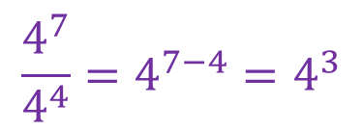

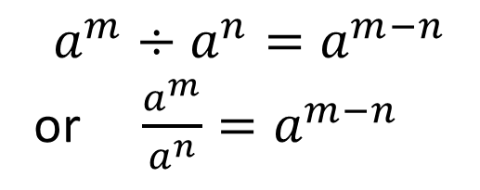
24
7
30
Date
Index Laws
EQ – Describe how the index laws can be used to simplify expressions with indices.
What are the index laws?
Index Law One
Example
$$a^{m}×a^{n}=a^{m+n}$$
$$4^{7}×4^{4}=4^{7+4}=4^{11}$$
Index Law Two
$$a^{m}÷a^{n}=a^{m−n}$$
or $\frac{a^{m}}{a^{n}}=a^{m−n}$
$$4^{7}÷4^{4}=4^{7−4}=4^{3}$$
$$\frac{4^{7}}{4^{4}}=4^{7−4}=4^{3}$$
5

Slide 19
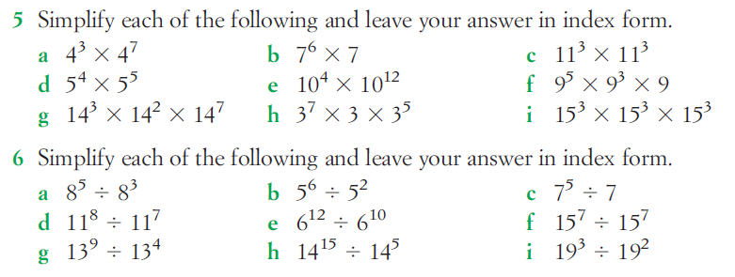
Questions

Slide 20
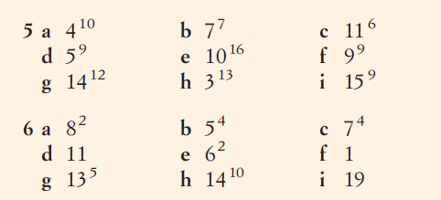
Answers

Slide 21
Notes Review
24, 7 ,30
Date
Title
Essential question
Notes complete
Notes complete with colour and diagrams
Questions completed
Contents page filed in
Formula page filled in

Slide 22
Homework
Review your notes and write a summary answering the essential question.

